Slide 1


HOTEL RESERVATION
ANALYSIS
ON SQL

Slide 2
Dataset Details
The dataset includes the following columns:
· Booking_ID: A unique identifier for each hotel reservation.
· no_of_adults: The number of adults in the reservation.
· no_of_children: The number of children in the reservation.
· no_of_weekend_nights: The number of nights in the reservation that fall on weekends.
· no_of_week_nights: The number of nights in the reservation that fall on weekdays.
· type_of_meal_plan: The meal plan chosen by the guests.
· room_type_reserved: The type of room reserved by the guests.
· lead_time: The number of days between booking and arrival.
· arrival_date: The date of arrival.
· market_segment_type: The market segment to which the reservation belongs.
· avg_price_per_room: The average price per room in the reservation.
· booking_status: The status of the booking.

Slide 3
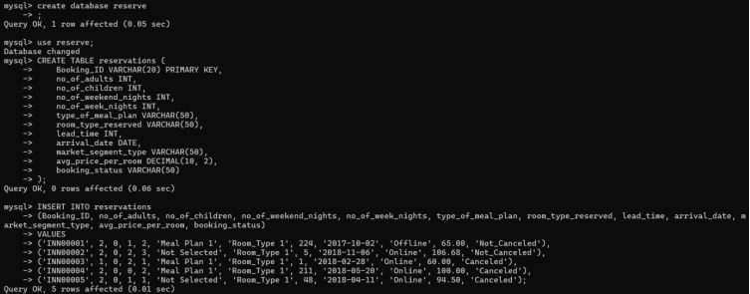
First we created a database and then used it the created a table and then inserted the details in it

Slide 4
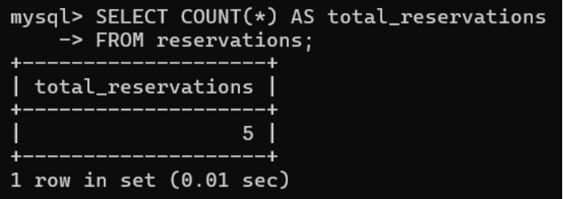
Q - What is the total number of reservations in the dataset?

Slide 5
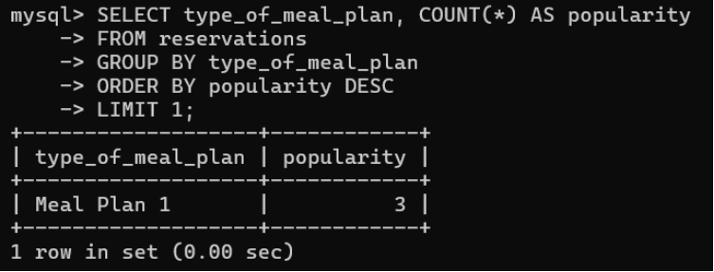
Q. Which meal plan is the most popular among guests?

Slide 6
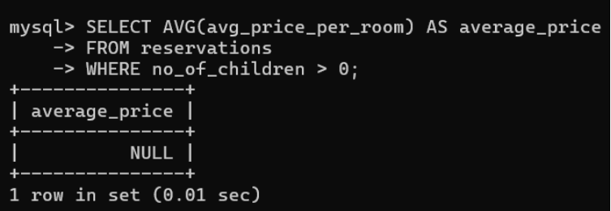
Q. What is the average price per room for reservations involving children?

Slide 7
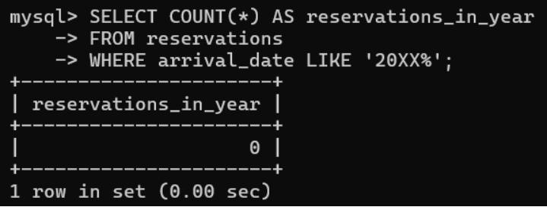
Q. How many reservations were made for the year 20XX (replace XX with the desired year)?

Slide 8
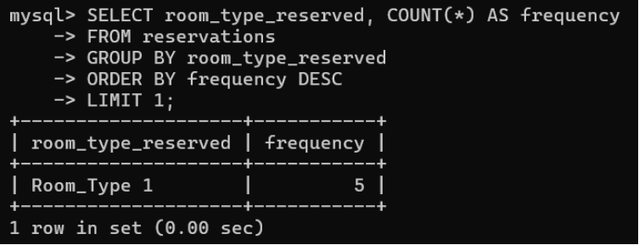
Q. What is the most commonly booked room type?

Slide 9
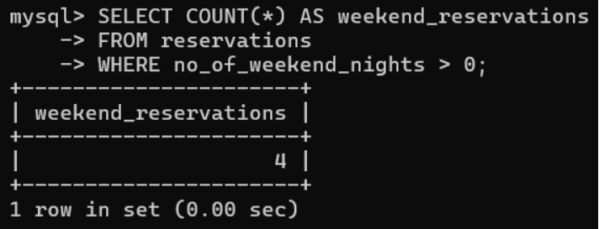
Q. How many reservations fall on a weekend (no_of_weekend_nights > 0)?

Slide 10
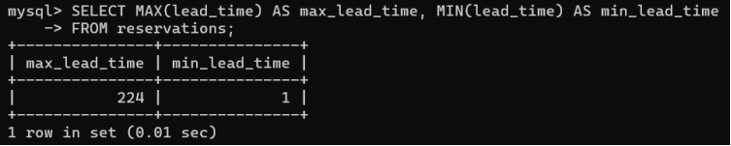
Q. What is the highest and lowest lead time for reservations?

Slide 11
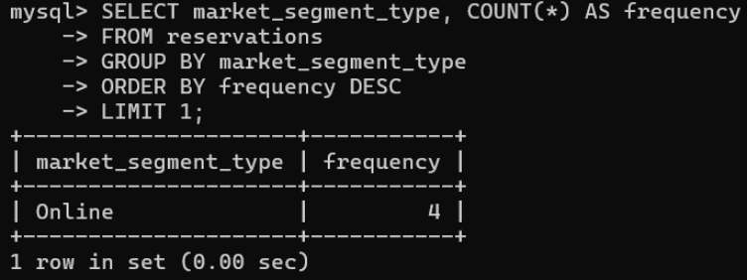
Q. What is the most common market segment type for reservations?

Slide 12
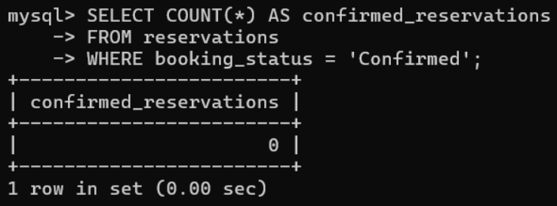
Q. How many reservations have a booking status of "Confirmed"?

Slide 13
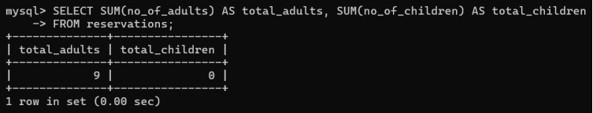
Q. What is the total number of adults and children across all reservations?

Slide 14
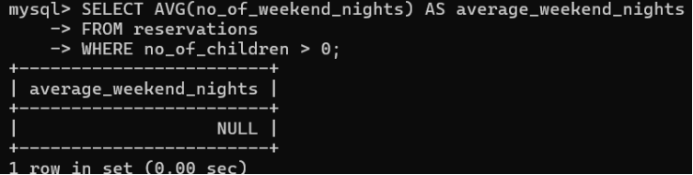
Q. What is the average number of weekend nights for reservations involving children?

Slide 15
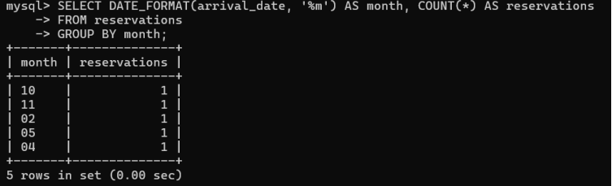
Q. How many reservations were made in each month of the year?

Slide 16
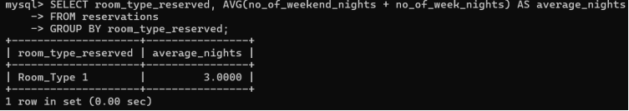
Q. What is the average number of nights (both weekend and weekday) spent by guests for each room type?

Slide 17
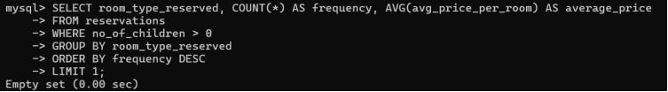
Q. For reservations involving children, what is the most common room type, and what is the average price for that room type?

Slide 18
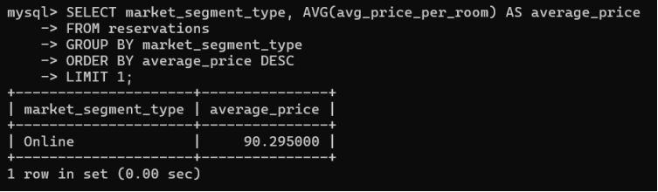
Q. Find the market segment type that generates the highest average price per room.

Slide 19
Thank you!

